Slide 1
Social media campaign
ON FACEBOOK

Slide 2
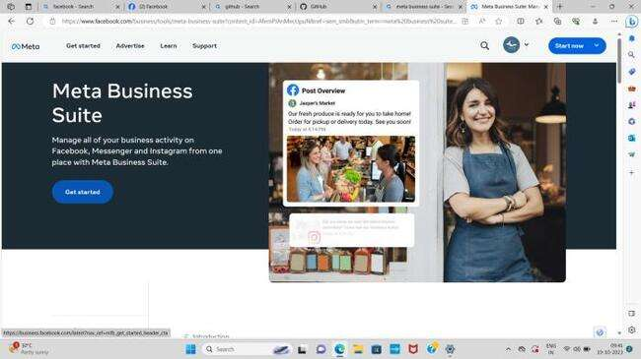

1) Open Facebook Business page, click on Get started.

Slide 3
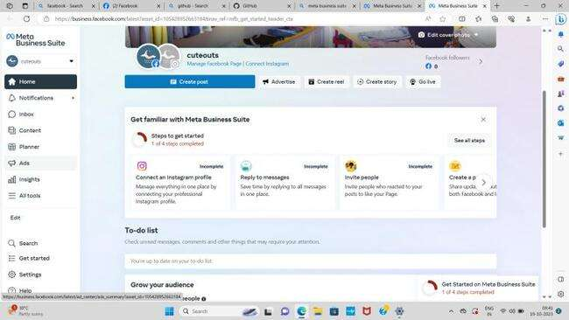
2) Open the Ads option.

Slide 4
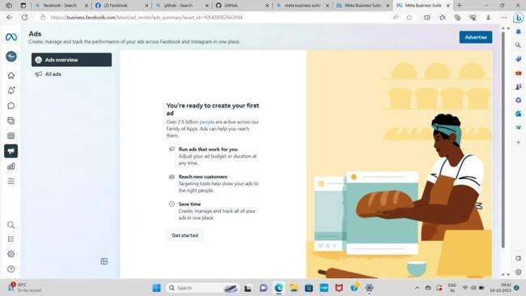
3) In ads option, click on Advertise.

Slide 5
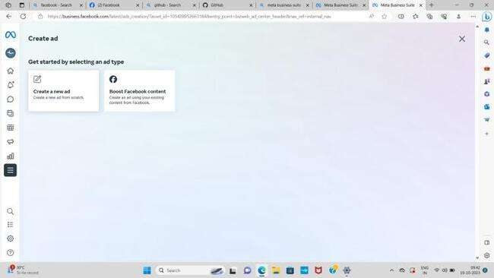

4) Click on create a new ad.

Slide 6
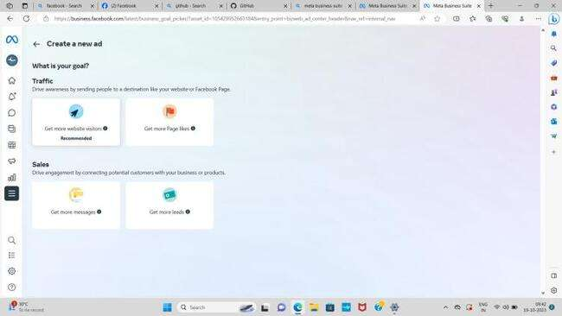
5) After clicking on create a new ad, choose the goal.

Slide 7
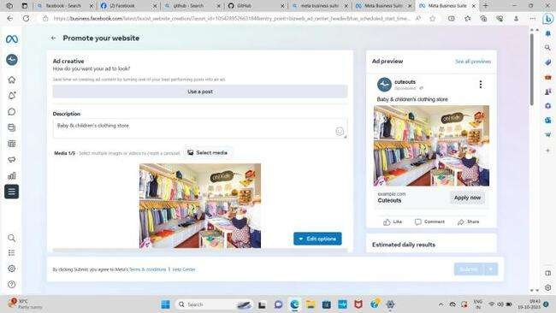
6) Give description for your ad.

Slide 8
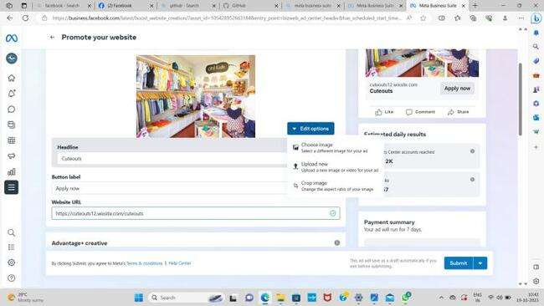

7) Upload medias for the post and give the website URL.

Slide 9
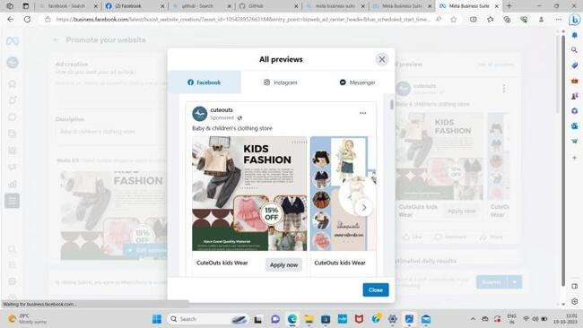
8) Preview the Ad post.

Slide 10
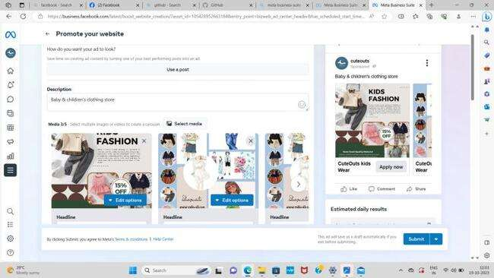

9) After previewing, submit the ad.

Slide 11
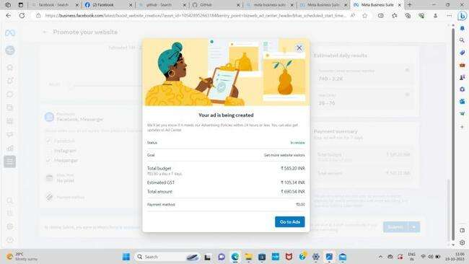
10) Now the ad is being created.

Slide 12
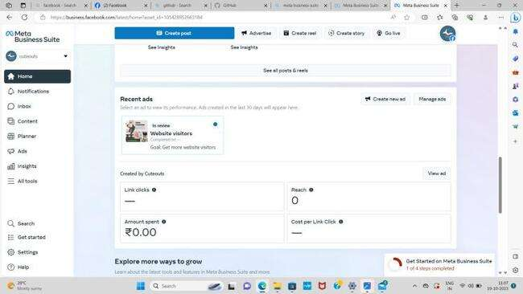
11) Lastly, the ad for the brand is now posted on the social media page.

Slide 13
Video link:
https://fb.watch/nNPIooounH/?mibextid=Nif5oz

Slide 14
Thank you!

